Slide 1
Managing Software with SD-UX
Version A.01
H3064S Module 19 Slides

Slide 2
Introducing SD-UX
Managing Software On Your Local Host
Installing Software
Copying Software
Removing Unwanted Software
Listing Software
Verifying Installations
Packaging Software
Configuring Software
a538211

Slide 3
SD-UX Software Structure
Bundle
Product A
Product B
fileset
fileset
fileset
Sub
Product
1
Sub
Product
2
fileset
fileset
fileset
fileset
fileset
a66996

Slide 4

SD-UX Software Depots
swcopy
Depot
swinstall
System
Files
a66997

Slide 5
The SD-UX IPD
swinstall
swremove
Accounting B.10.20
AdvJournalFS B.10.20
AudioSubsystem B.10.20
CDE B.10.20
DiskQuota B.10.20
International B.10.20
InternetSrvcs B.10.20
JournalFS B.10.20
Keyshell B.10.20
LVM B.10.20
Maintained by SD-UX utilities
Records installed software
a66998

Slide 6
SD-UX Daemon/Agents
Process
swagentd
swagent
Description
Listens for requests, then schedules a “swagent” to do the work
Initiates communication between the target and the source
There must be one swagentd running on the system to use “SD-UX” commands
Performs software management tasks
Started as needed by “swagentd”
a538215

Slide 7
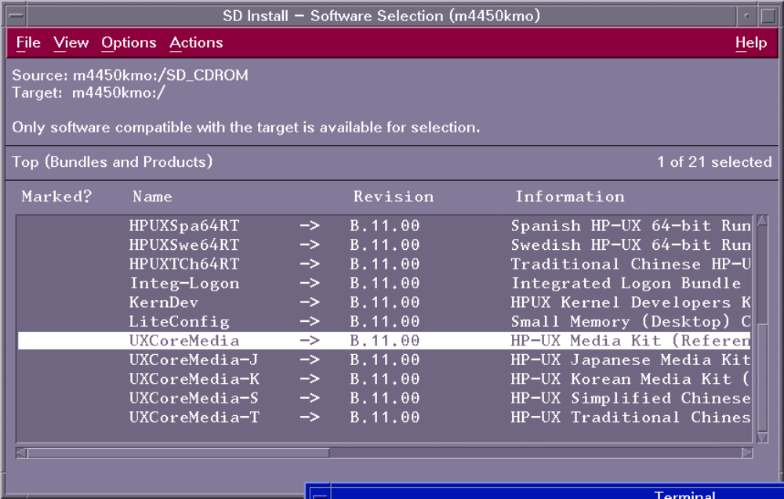
swinstall Main Menu
a64917

Slide 8
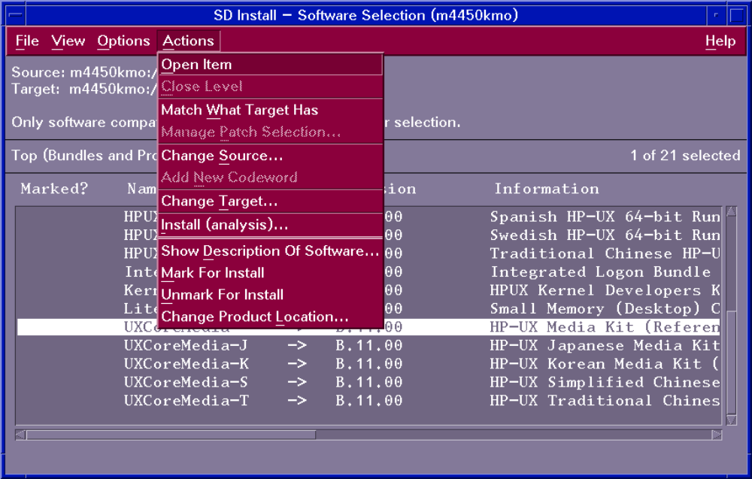
Selecting Software to Install
a66999

Slide 9
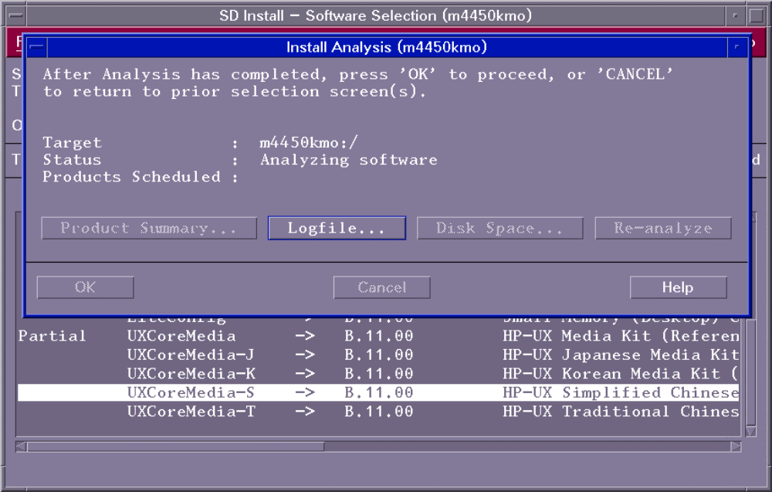
Start the Update
a6495

Slide 10
Installing Protected Software
Product
ID
Customer
ID
CD Part No.
Codeword
Generator
Codeword
a669100

Slide 11
Listing Software
Installed
Products
Database
Depot
swlist
List installed software
List software in a depot
a669143

Slide 12
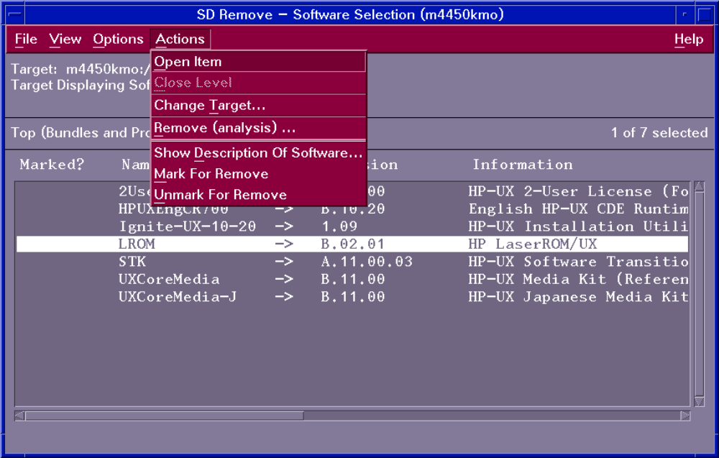
Removing Software
a6497

Slide 13
SD-UX Command Summary
SD-UX Command Purpose
swinstall Install software
swremove Remove software
swpackage Package software into a depot
swcopy Copy software from one depot to another
swlist List software in a depot or installed on a system
swreg Make a depot visible to other systems
swverify Verifies the integrity of installed software and depot software
swconfig Configures and unconfigures installed software
swacl Change access to SD-UX software objects
swagentd Distribution daemon
a669101

